Slide 1

Bank Management System
This project aims to develop a user-friendly and efficient Bank Management System, enabling users to perform various banking operations conveniently.
AN

Slide 2

Abstract
1
Purpose
2
Features
3
Technology
The Bank Management System aims to streamline banking processes by automating tasks and providing a centralized platform for user interactions.
The system will offer features such as user registration, account management, transaction history, and secure login functionalities.
The system will be developed using Java JDK, MySQL database, and a user-friendly graphical interface.

Slide 3

Introduction
1
Need
Traditional banking systems often involve manual processes, which can be time-consuming and prone to errors.
2
Solution
This project aims to address these challenges by implementing a robust and efficient Bank Management System.
3
Benefits
The system will provide a user-friendly interface, improved security, and enhanced efficiency for both customers and bank employees.

Slide 4
UI Design using Java JDK
Swing Framework
Components
Layout
The user interface will be designed using Java Swing, a powerful framework for creating graphical user interfaces.
The UI will include various components such as text fields, buttons, drop-down menus, and tables for user interaction.
The system will utilize a well-structured layout to ensure user-friendliness and efficient navigation.

Slide 5

Connect with XAMPP MySQL
MySQL Database
XAMPP Server
JDBC Connection
The system will leverage MySQL database to store and manage all the data related to users, accounts, and transactions.
XAMPP will be used as a local development environment, providing a seamless way to set up and manage the MySQL database.
The Java Database Connectivity (JDBC) API will be used to establish a connection between the Java application and the MySQL database.

Slide 6
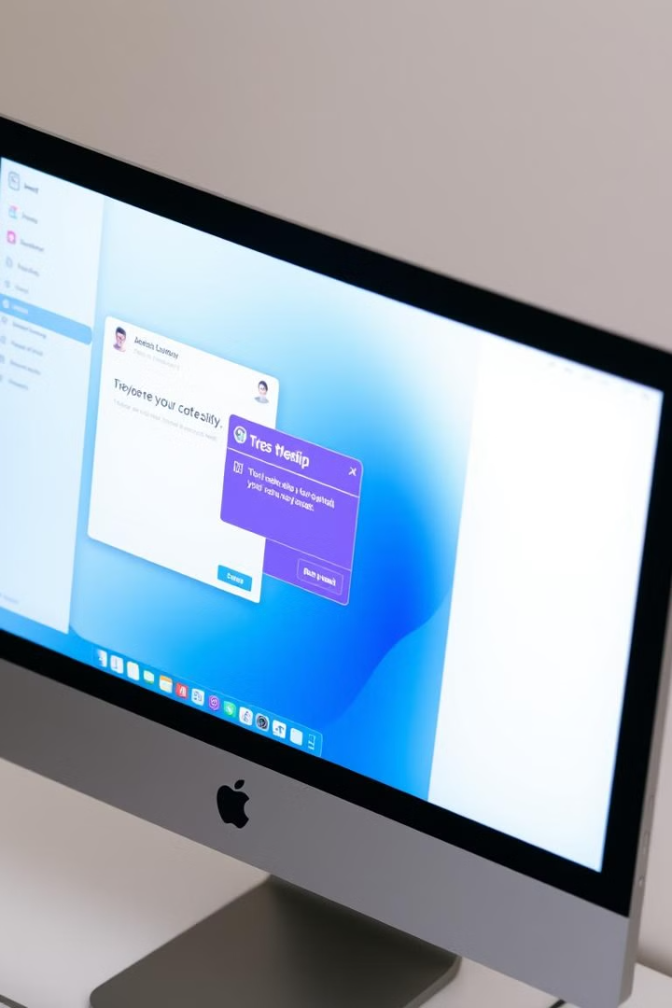



Implementation and Pop-up Messages
Success
Upon successful completion of an operation, the system will display a confirmation pop-up message.
Error
In case of errors or invalid input, the system will display an error pop-up message, guiding the user to rectify the issue.
Information
The system will provide informative pop-up messages to guide users through various processes and ensure a smooth experience.

Slide 7




User Registration and Login
Registration
Users will be able to create new accounts by providing their personal details and choosing a unique username and password.
Login
Once registered, users can log in using their credentials to access their accounts and perform various banking operations.
Security
The system will implement strong security measures to protect user data and ensure secure login processes.

Slide 8

Add Account, Update Account, Delete Account, Search Account
Add Account
Allows users to create new bank accounts, specifying account type and initial deposit.
Update Account
Enables users to modify account details, such as name, address, or contact information.
Delete Account
Provides users with the ability to permanently close their accounts.
Search Account
Allows users to search for specific accounts using various criteria, such as account number or name.

Slide 9
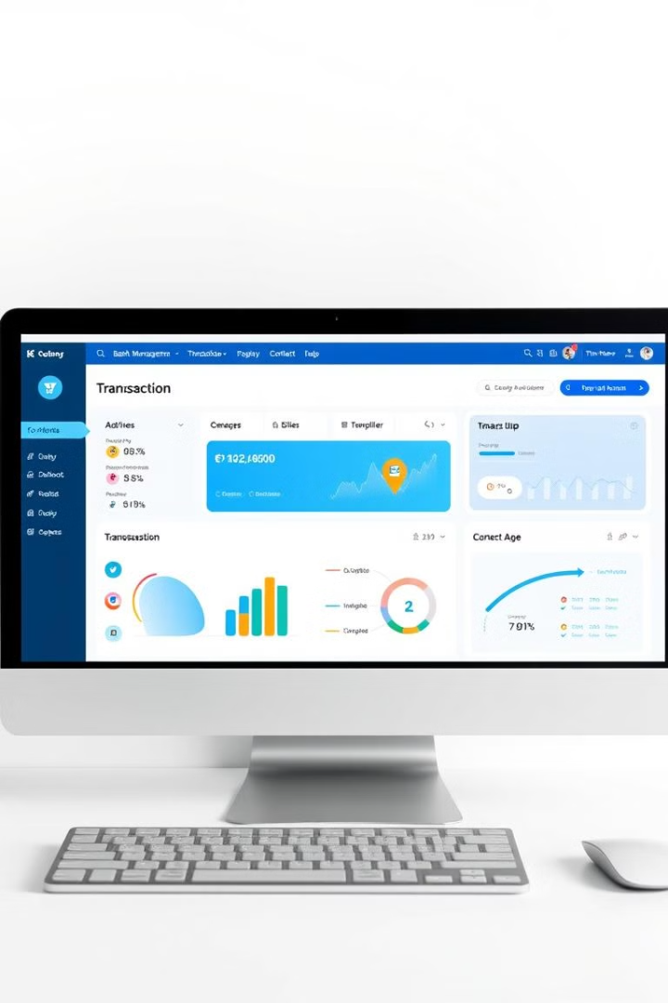
Results
1
Functionality
2
User Experience
The Bank Management System successfully implements all intended features, allowing users to perform essential banking operations.
The system provides a user-friendly interface and intuitive navigation, making it easy for users to perform various banking tasks.
3
Performance
The system demonstrates efficient performance, handling user requests and data operations promptly.

Slide 10

Discussion
Security
Scalability
Mobile Integration
Future improvements could focus on enhancing security measures, implementing multi-factor authentication, and data encryption.
The system can be further optimized for scalability to accommodate a growing number of users and transactions.
Developing a mobile application would provide users with convenient access to banking services from their smartphones.

